Slide 1
DOIs and INTERMAGNET
Kirsten Elger
GFZ Data Services
GFZ German Research Centre for Geosciences, Potsdam, Germany
INTERMAGNET Workshop, Ottawa (20-22 July 2019)

Slide 2
What is a DOI?
Digital Object Identifier
A globally unique and permanent identifier for digital objects (link)
With metadata and licence
Persistent = long term data access guaranteed by the publisher
DOI-referenced datasets:
are directly accessible via the DOI link
link to the exact data used for research results → reproducibility
are citable in scholarly literature → tracking, → credit for researchers and institutions
DOI metadata increases data discoverability (via catalogues)
DOI → URL

Slide 3
Coalition on Publishing Data in the Earth and Space Sciences
Data Publications are citable in research articles (COPDESS Statement of Commitment)
STATEMENT OF COMMITMENT
(January 2015)
data should be stored in appropriate domain repositories.
citations of data sets should be included within reference lists.
include in research papers concise data availability statements.
links to data sets in publications and corresponding links to journals in data facilities
http://www.copdess.org/statement-of-commitment/

Slide 4
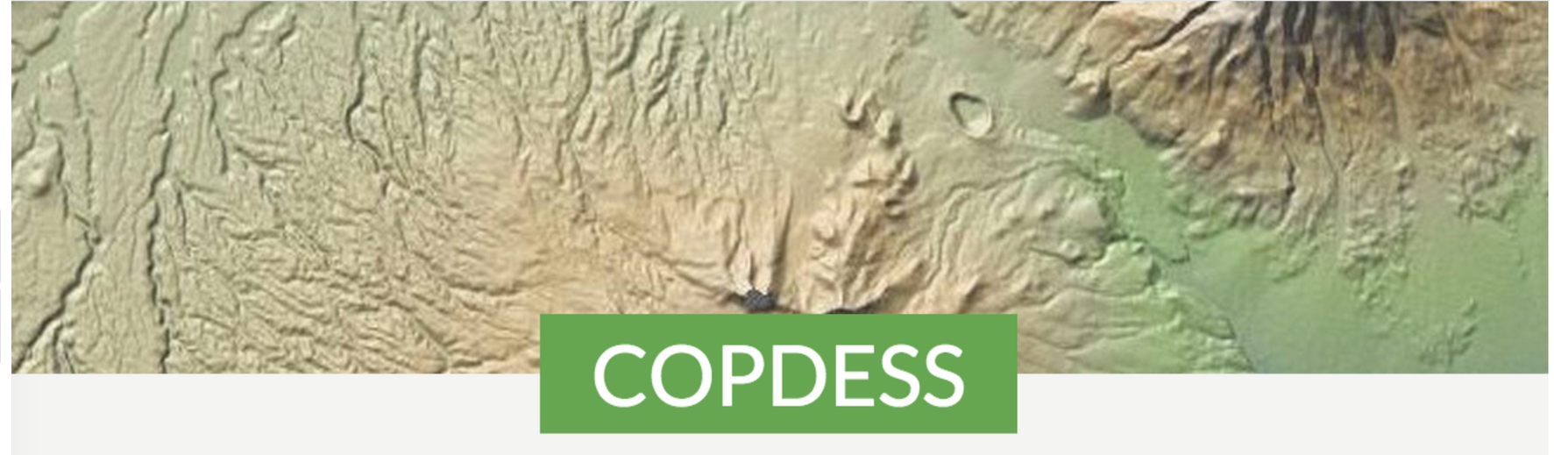
Recent agreements between publishers, repositories, funders, …
Data availability statement required for articles
Citation of data in reference lists allowed by journals
Recommendation to use domain repositories
No data supplements anymore (→ data publication via repositories)
2012
2018

Slide 5
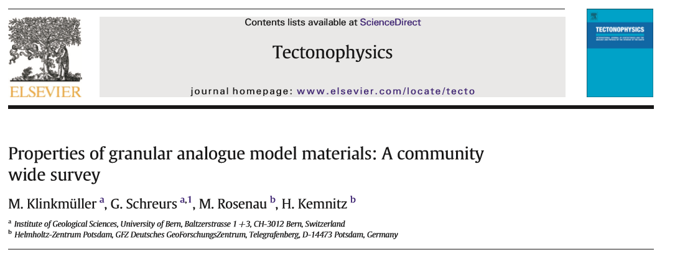
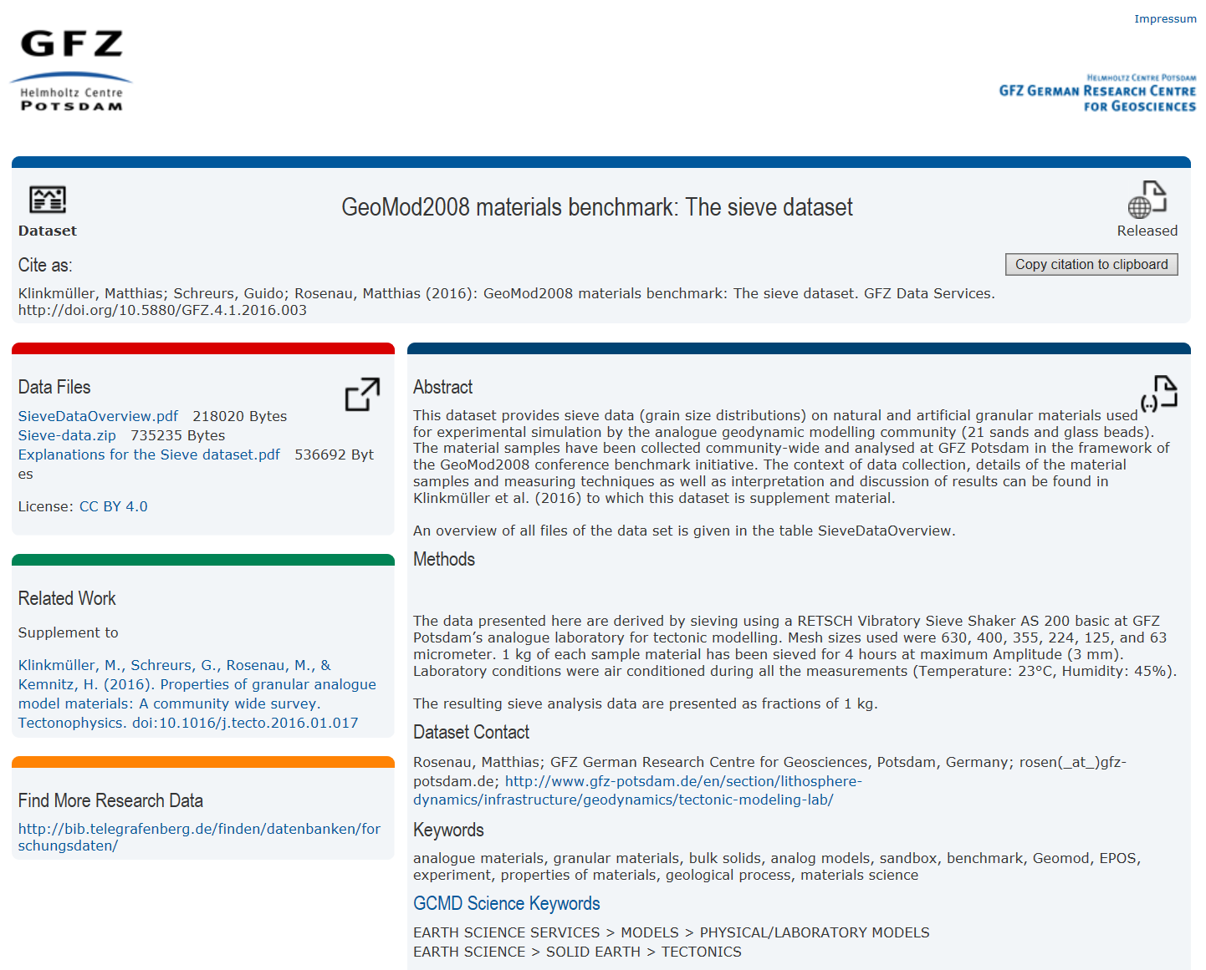
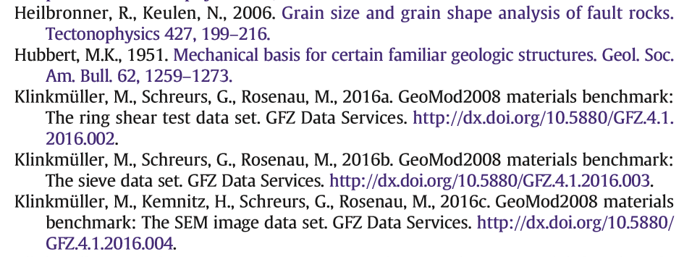
How to cite a Data DOI?
3. Data access via DOI
Link to paper
1. Citation in the text
2. Dataset-DOI in the References

Slide 6
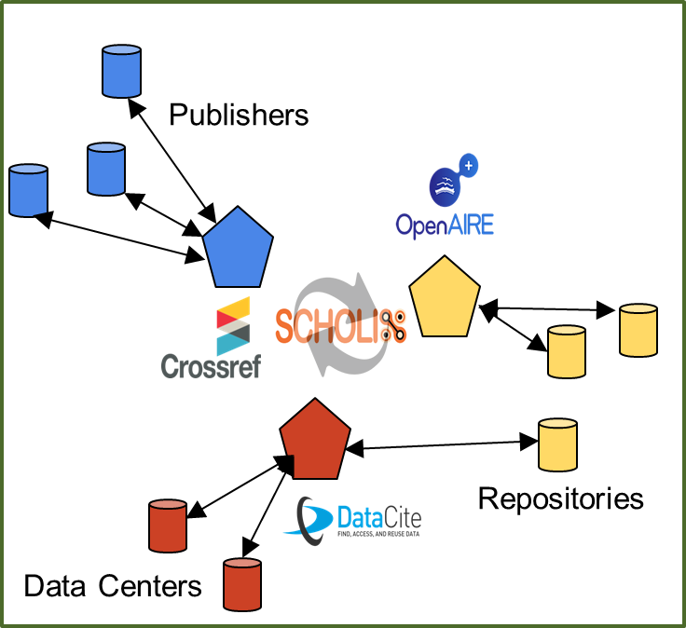
Scholix: linking data with papers
“interoperability framework for exchanging information about the links between scholarly literature and data”
Credit: Wouter Haak, Elsevier

Slide 7
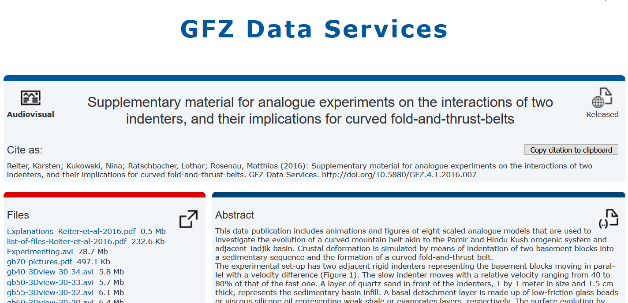
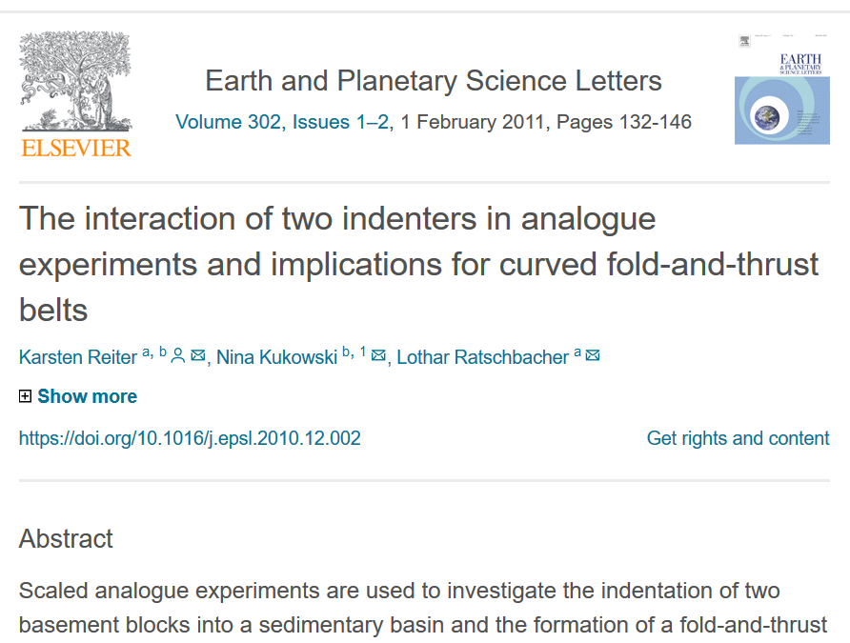
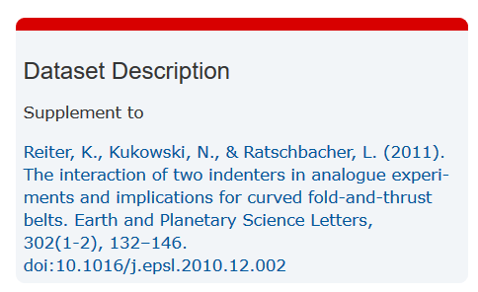
The classical approach (before Scholix)
data publication in 2016
…supplement to an article from 2011
Data: http://doi.org/10.5880/GFZ.4.1.2016.007, Paper: https://doi.org/10.1016/j.epsl.2010.12.002
Notes:
Die Möglichkeiten der Services werden immer weiter ausgebaut
Because we are following international metadata standards and protocols, it is now possible to link data with papers even years after the publication of the data.
This is a dataset that we have published in 2016 – as a supplement to a paper from 2011. As the related article was already printed for five years, we cannot add the citation of the dataset to the paper anymore. However, as this relation and the link to the paper is included in the metadata of the data (DOI landing page), some publishers have developed a workflow to add this information to the Landing Page of the paper – together with a direct link back to the data!

Slide 8
The classical approach (before Scholix)
X
data publication in 2016
paper published in 2011
Link to paper in the metadata of the data publication
Is not possible to add the citation of the dataset to the paper 5 years after publishing
Data: http://doi.org/10.5880/GFZ.4.1.2016.007, Paper: https://doi.org/10.1016/j.epsl.2010.12.002
Notes:
Die Möglichkeiten der Services werden immer weiter ausgebaut
Because we are following international metadata standards and protocols, it is now possible to link data with papers even years after the publication of the data.
This is a dataset that we have published in 2016 – as a supplement to a paper from 2011. As the related article was already printed for five years, we cannot add the citation of the dataset to the paper anymore. However, as this relation and the link to the paper is included in the metadata of the data (DOI landing page), some publishers have developed a workflow to add this information to the Landing Page of the paper – together with a direct link back to the data!

Slide 9
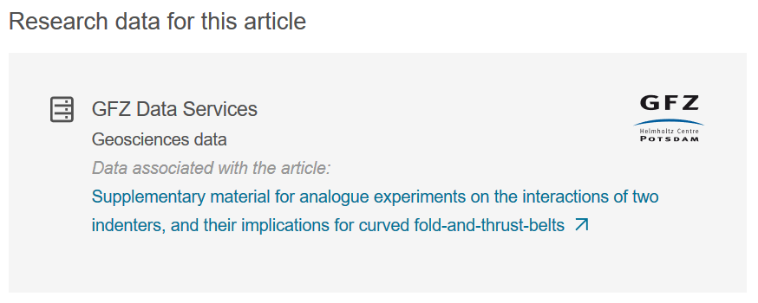
New possibilities for cross-linking data and papers
data publication in 2016
paper published in 2011
new
Link to data on the paper landing page
Data: http://doi.org/10.5880/GFZ.4.1.2016.007, Paper: https://doi.org/10.1016/j.epsl.2010.12.002
Notes:
Die Möglichkeiten der Services werden immer weiter ausgebaut
Because we are following international metadata standards and protocols, it is now possible to link data with papers even years after the publication of the data.
This is a dataset that we have published in 2016 – as a supplement to a paper from 2011. As the related article was already printed for five years, we cannot add the citation of the dataset to the paper anymore. However, as this relation and the link to the paper is included in the metadata of the data (DOI landing page), some publishers have developed a workflow to add this information to the Landing Page of the paper – together with a direct link back to the data!

Slide 10
„Status Quo“ as of today

Slide 11
DOIs for definitive data – metadata comparison
Addis Ababa University, Institute Of Geophysics, Space Science And Astronomy (Ethiopia)… Yu. G. Shafer Institute Of Cosmophysical Research And Aeronomy SB RAS (Russia). (2017). Global magnetic observatory data 2013 [Data set]. INTERMAGNET. https://doi.org/10.5880/intermagnet.2013
USGS. (1901). USGS Geomagnetism Program Definitive Data. INTERMAGNET. https://doi.org/10.7914/sn/nt
Bureau Central De Magnétisme Terrestre (BCMT), Bcmt@Ipgp.Fr. (1921). French Global Network of Geomagnetic observatories [Data set]. Bureau Central de Magnétisme Terrestre (BCMT). https://doi.org/10.18715/bcmt.mag.def
Missing ressource type (→ update to dataCite Schema 4)
Different Publisher
Authors (year) title [ressource type]. Publisher. DOI

Slide 12
Future plans for INTERMAGNET definitive data-DOIs
INTERMAGNET DOI for 2014 definitive data similar to the 2013 dataset
2015: Publication of the full INTERMAGNET definitiv data from 1991 – 2015 including all changes/ updates of the already published CDs/ DVDs/ USB (Intermagnet Reference Data Set IRDS)
From 2016 on: annual update of the IRDS as new DOI Version including changes of the previous publication (no publication on physical media anymore)

Slide 13
More magnetic data products with DOI (incomplete)
(GFZ) Matzka, Jürgen et al (2019): The Hp geomagnetic index test dataset 2003, 2004, 2005 and 2017. GFZ Data Services. http://doi.org/10.5880/GFZ.2.3.2019.002
(GFZ) Preliminary minute means from two observatories for specific periods (Tatuoca 2008-2017, Villa Remedios: 10/2010 and 01/2013
(GFZ) Hourly mean values for St Helena (2010, preliminary), Huancayo 1935-1985 and 1958-2013 (horizontal component) – cited in the INTERMAGNET DOI
(GFZ) Kp Index DOI coming soon
(GCRAS) DOIs for data from 21 magnetic observatories in Russia (minted via CrossRef): Variational Minute Values 1983-2013

Slide 14
How to make magnetic data products visible?
Have they used INTERMAGNET data → inclusion of the INTERMAGNET DOI in Landing pages
Are any of the published datasets part of the INTERMAGNET definitive dataset?
Would it make sense to provide a „data publications“ section on the INTERMAGNET website (at least for INTERMAGNET Stations)?

